Slide 1
Project Review 1: Comparison of TCP Variants over Routing Protocols in MANET
Notes:
Good afternoon everyone.. our project topic is comparison of tcp variants over routing protocols in manet. This is our review 1.

Slide 2
Team
Members
Under the guidance of
Dr. P. Varalakshmi
BATCH 1
N. Hemanth 2019503519
P. Ramyaa 2019503547
G V. Sudharsan 2019503565
Notes:
I am Ramyaa and I am working with my teammates Hemanth and Sudharsan.In the last review, we were instructed to do the simulation for the existing works, and we acknowledge that we tried simulating most of the existing works in the tcp variants over manet routing protocols and derived conclusions from the same.

Slide 3
TCP SIMULATIONS
Notes:
In order to figure out the best tcp variant for a particular manet protocol we will have to simulate tcp variants and manet routing protocol types in multiple scenarios. First we will see about tcp simulations.

Slide 4
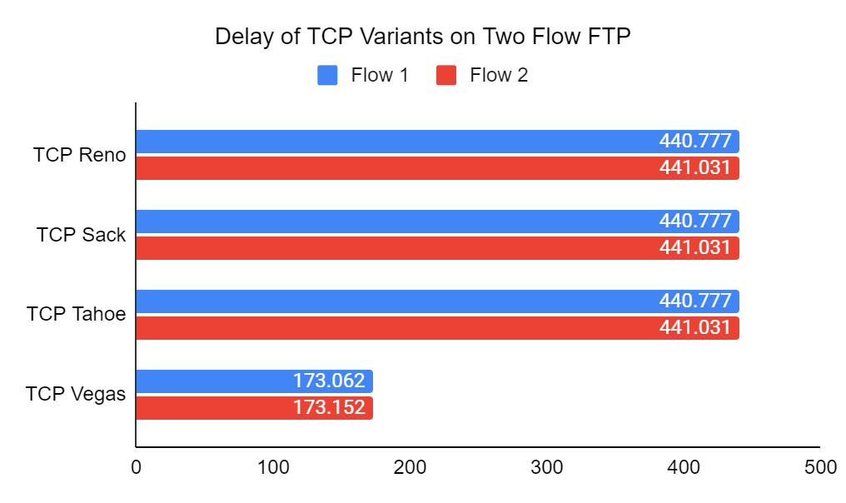
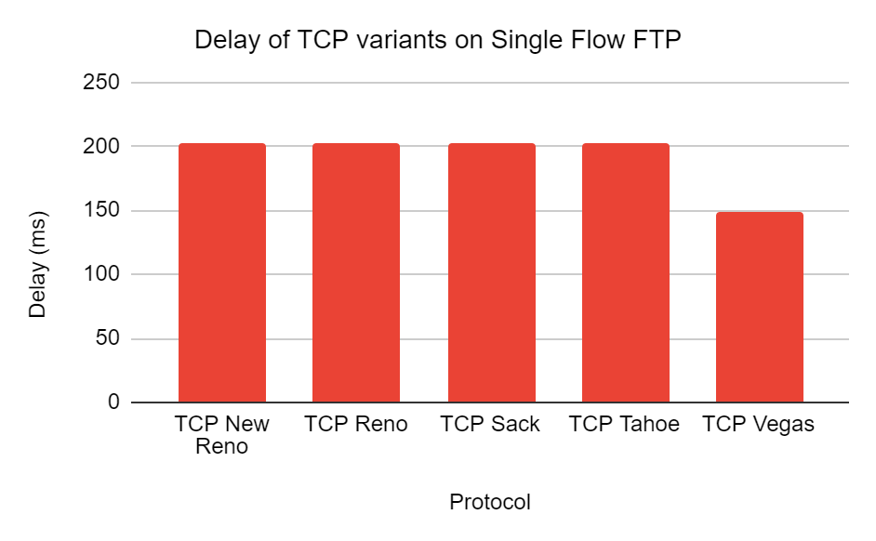
FTP traffic has been run on single and multiple flows and results are recorded. Average delay of all the variants is more or less alike and TCP Vegas shows 25% lesser average delay than other variants. In other words, TCP Vegas performs superior on two flows than other variants keeping average delay under discussion. It is evident that as loss rate increases, throughput decreases. Similarly congestion window size also decreased.
Notes:
Here we have run ftp traffic on single and multiple flows. a flow network (also known as a transportation network) is a directed graph where each edge has a capacity and each edge receives a flow. The amount of flow on an edge cannot exceed the capacity of the edge. Even though the average delay of variants look alike as concluded from the graph, tcp vegas shows 25% less delay than others also decreasing the congestion window size. Speaking of congestion let’s see how it varies over tcp.

Slide 5
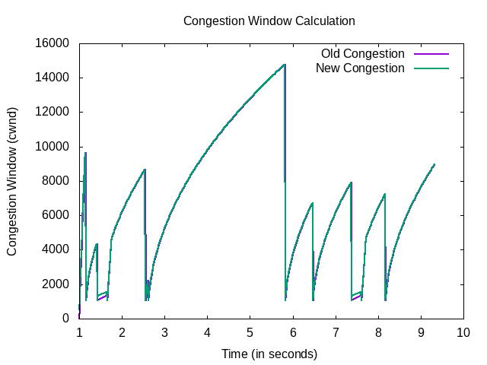
From this Congestion Window Graph generated using NS3 we understand the following
The Congestion reaches a maximum of more that 14000 and drops.
After the major drop the congestion goes through increase.
This increase reaches maximum and drops back. This occurs multiple times.
The network stabilises over time.
Old and New congestion don’t vary massively.
Notes:
Congestion Window (cwnd) is a TCP state variable that limits the amount of data the TCP can send into the network before receiving an ack. They are used to regulate data flow in TCP connections, minimize congestion, and improve network performance.This graph is achieved using seventh.cc file. There are two nodes (node 0 and node1). They both use point to point protocol with data rate 5mbps and bandwidth 2ms delay.
Here in the graph we can clearly see the
1. Slow start threshold (exponential increase of packets)
2. Congestion Avoidance (additive increase)
3. congestion detection (multiplicative decrease) .
We can also conclude that in tcp The old and new congestion are very similar to each other.. They are almost the same.

Slide 6
Conclusion on TCPs
We have calculated the performance of TCP variants; TCP Tahoe, TCP Reno, TCP New Reno and TCP Vegas. After analyzing the performance from simulated data, we have found that TCP Vegas is better than other TCP variants for sending data and information. In essence, TCP Vegas dynamically increases or decreases transmission of data according to the window size of sending packets of observed RTTs, whereas TCP Tahoe and Reno continue to increase their window size until packet loss is detected. Simulation, implementation and experimentation conclude that TCP Vegas can provide higher throughput than any other TCP variants. The accuracy of our analysis is validated by comparing the simulation results. We conclude stating that the performance of TCP Vegas is much better than any other TCP variants where congestion is occurred in two point junction. Comparison of TCP variants with respect to other remaining network parameters would be an important future attempt. Such type of analysis is very helpful for selecting the appropriate TCP in ad hoc networks.
The drawback of simulation is that inherently runs the risk of oversimplification. It is not possible to exactly replicate the entire world inside a computer model, so when creating a simulation some factors must be statistically or otherwise approximated
Notes:
Despite the drawbacks that simulation runs on oversimplification we have decided that tcp vegas is better when it comes to transmission of data due to the window size and throughput observed in two point junctions. But tcp reno and tahoe have an increasing packet loss.

Slide 7
MANET ROUTING PROTOCOL SIMULATIONS
Notes:
next we’ll check out the simulations based on manet routing protocols

Slide 8
INTRODUCTION TO MANET SIMULATION
An ad hoc network is a group of wireless mobile computers (or nodes) in which nodes cooperate by forwarding packets for each other to allow a node to communicate beyond its direct wireless transmission range. a multi-hop scenario occurs, where several intermediate hosts relay the packets sent by the source host before they reach the destination host. The network topology may change with time as the nodes move or adjust their transmission and reception parameters. Routing protocols for ad hoc networks must deal with limitations such as high error rates, scalability, security, quality of service, energy efficiency, multicast, aggregation and node cooperation etc. Routing Protocols for wireless adhoc networks - Table Driven (Proactive) and On-demand (Reactive) Proactive: Destination Sequenced Distance Vector (DSDV) , OLSR (Optimized Link State Routing) Reactive: Ad hoc On Demand Distance Vector (AODV), Dynamic Source Routing (DSR)
Performance comparison of AODV, DSDV, OLSR and DSR routing protocols in a constrained situation is done and results are tabulated, graphs are drawn and conclusion have been drawn from them Performance and Simulation setup: Simulator: NS2 and NS3 No of nodes used in network creation: 17 ( NS2 suffers if nodes>100) Antenna height: 1.5 Propagation Model: Two ray ground Packet size and Traffic sources identified. Routing Protocols: AODV, DSDV, OLSR, DSR.
Notes:
A wireless ad hoc network or mobile ad hoc network is a decentralized type of wireless network. The network is ad hoc because it does not rely on a pre-existing infrastructure, such as routers in wired networks or access points in wireless networks. MANET is a type of ad hoc network. The routing protocol of manets must be able to deal with high error rates,scalability, security, quality of service and so on. MANET has two types of protocols namely proactive and reactive. Proactive has DSDV and OLSR . Reactive consists of AODV and DSR. We will be comparing these protocols next to find out the best performer. We used both ns2 and ns3 with 17 nodes for simulation purposes. Some other specs such as antenna height , propagation model is given. We have calculated in terms of preidentified packet size and traffic sources.

Slide 9
NAM VISUALIZATION
After setting up the network using NSG2.1 , TCL scripts are generated, using which the network animator shows how the network behaves during different intervals.
Visualization of the same has been done with NAM, for AODV, DSR and DSDV routing protocols, whose results are pasted in the slides to follow. The residual energy and instant throughput of the routing protocols are compared after writing the AWK scripts for the same, and the graphs are also plotted. For plotting the graph, gnuplot is used, which is very effective for visualizing the tabulated data in a graphical plot.
Notes:
Nam is a network animator that provides packet-level animation, protocol graphs, traditional time-event plots of protocol actions, and scenario editing capabilities. Nam benefits from a close relationship with ns, which can collect detailed protocol information from a simulation. We started off by setting up NSG2.1 which will allow or deny network traffic to your virtual machine instances in a virtual network. NSGs can be associated with subnets or individual virtual machine instances within that subnet. It allows direct designing of topologies instead of coding them. We have also used gnuplot to plot out data received from simulations.

Slide 10
SIMULATION PARAMETERS
Throughout the simulation, every node starts its journey from random spot to a random chosen destination. Once the destination is reached, the node takes a rest of your time in second and another random destination is chosen subsequently pause time. This repeats throughout inflicting continuous changes within the topology of the underlying network, totally different network state of affairs for varieties of nodes and pause times square measure generated
Packet Delivery Ratio (PDR): The packet delivery ratio is the ratio of packets successfully received to the total sent.
Average End-to-End Delay :Average amount of time taken by the packets to reach to the destination in seconds.
Throughput: Total Range of packets received by the destination. It is a live of effectiveness of a routing protocol
Energy Consumption: Energy consumption of a node is mainly due to the transmission and the reception of data or controlling packets.
Notes:
Throughout the simulation, every node starts its journey from random spot and moves to a random destination. The node takes a rest of your time in second after reaching the destination and another random destination is chosen subsequently to travel to. This repeats causing variable changes within the topology of the network (in our case manet). State of affairs for varieties of nodes and pause times square measure is also generated. We have also explained some of the parameters here such as packet delivery ratio which is number of packets received by the packets sent. Average end to end delay is average time taken by the packets to reach the destination node. Throughput is the rate at which information is sent through the network. Energy consumptions is the energy used in the process. Now over to my teammate hemanth.

Slide 11
USING NAM AND TCL SCRIPTS:
Nam (Network Animator) is an animation tool to graphically represent the network and packet traces. To be able to run a simulation scenario, a network topology must first be created. In ns2, the topology consists of a collection of nodes and links. The simulator object has member functions which enables to create the nodes and define the links between them. The class simulator contains all the basic functions. Since ns was defined to handle the Simulator object, the command $ns is used for using the functions belonging to the simulator class.
Traffic agents (TCP, UDP etc.) and traffic sources (FTP, CBR etc.) must be set up if the node is not a router. It enables to create CBR traffic source using UDP as transport protocol or an FTP traffic source using TCP as a transport protocol. These are done using the NSG2.1 ( Network Scenario Generator ) Jar file.
Once the Network has been generated using NSG2.1, we can view the TCL script in the GUI available over there. Queue/DropTail/PriQueue is not supported by DSR, we have to go for CMUPriQueue. DSR does not obey the queue model as specified for AODV. DSR supports this queue called CMUPriQueue, it should reflect in the tcl code.

Slide 12
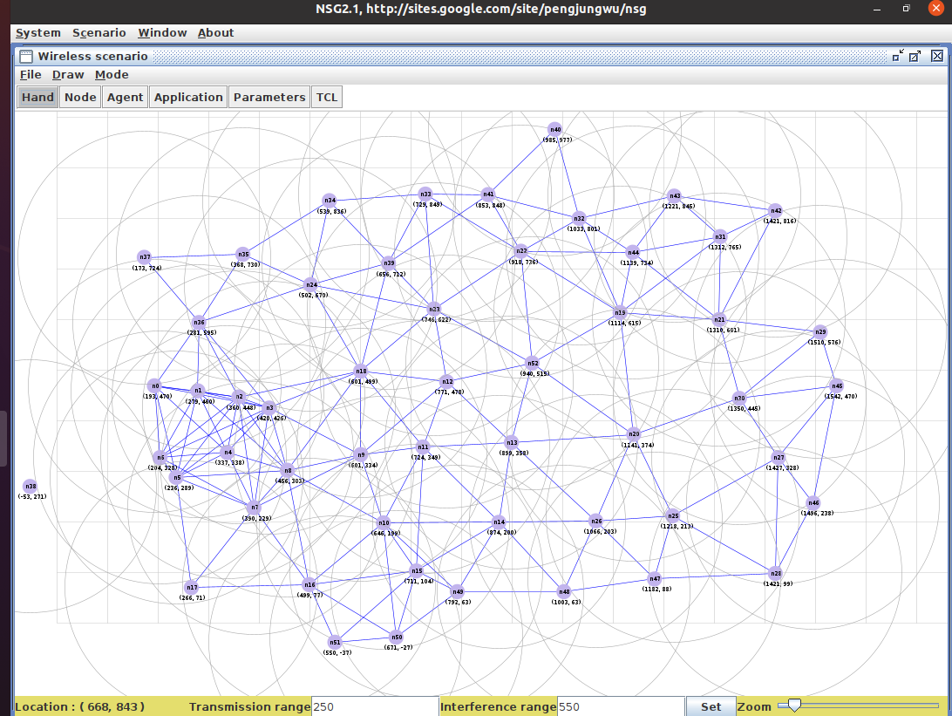
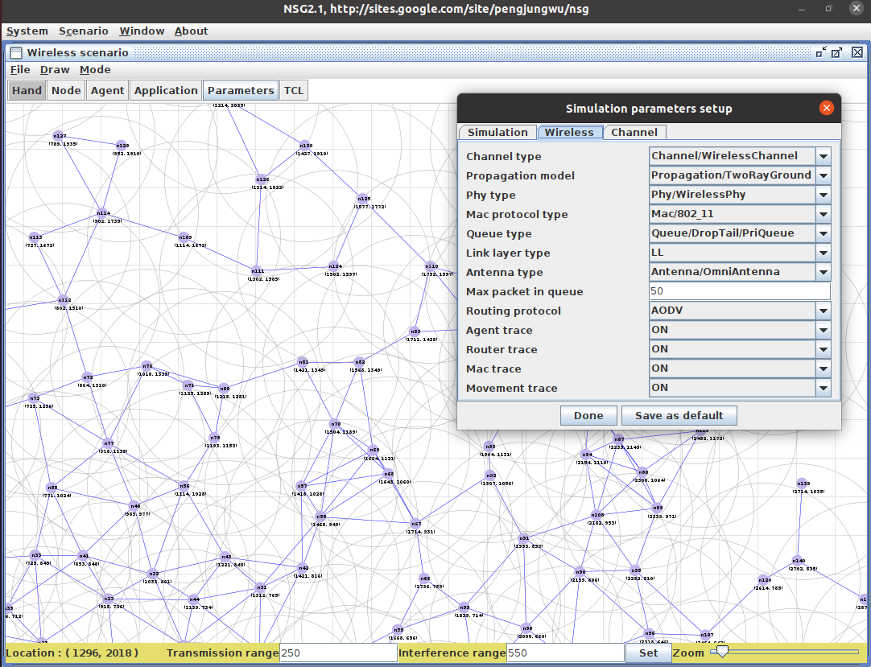
As seen in the GUI, Create a network with varying number of mobile nodes and the nodes are moving with a interference of certain meters and transmission range is defined, and other parameters are defined in the interface itself. Initially (25 nodes), OLSR outperforms AODV because it is proactive in nature and creates routes in advance, whereas AODV wastes some time in creating routes. The overhead of OLSR is small for smaller topologies, however, for larger topologies the significantly large routing overhead of OLSR degrades performance, creating interference in the network and causing loss of packets. These are detailed in the graphs in the below slides.

Slide 13
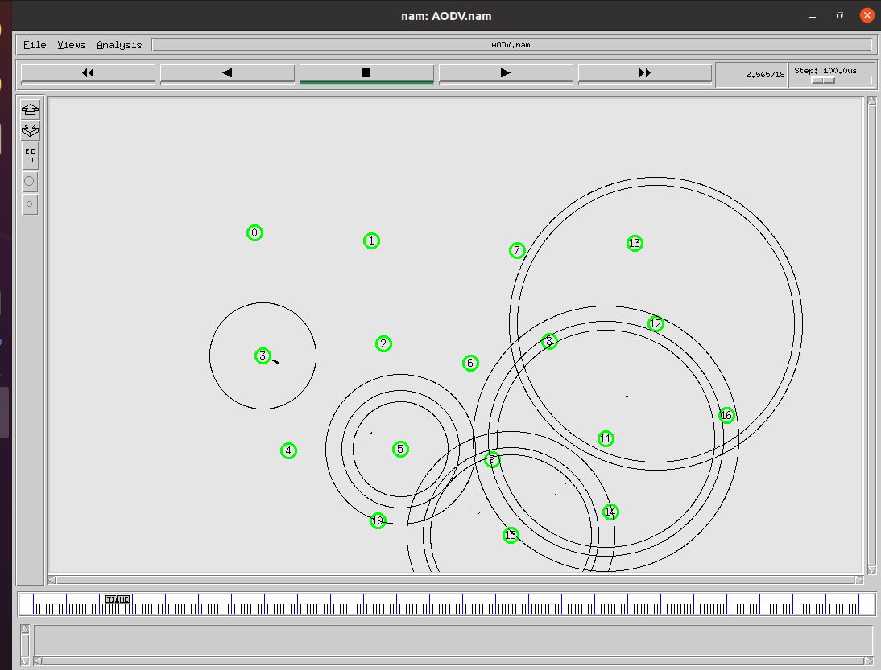
A Snapshot of the Simulation of AODV in NAM for 17 Mobile Nodes
( Small number, to analyze the performance of AODV )
The popular Two-Ray Ground radio propagation model is used to model the wireless communication. An Omni directional antenna transmits and receives signals equally, in all directions. That is, an Omnidirectional antenna transmits signals in a 360⁰ angle. The source, destination and next hop nodes are addressed by using IP addressing, and each nodes in the network maintains a routing table that consists the information about neighboring nodes. AODV supports multicasting as well as unicasting within a uniform framework. Each route has a lifetime after which the route expires if it is not used.

Slide 14
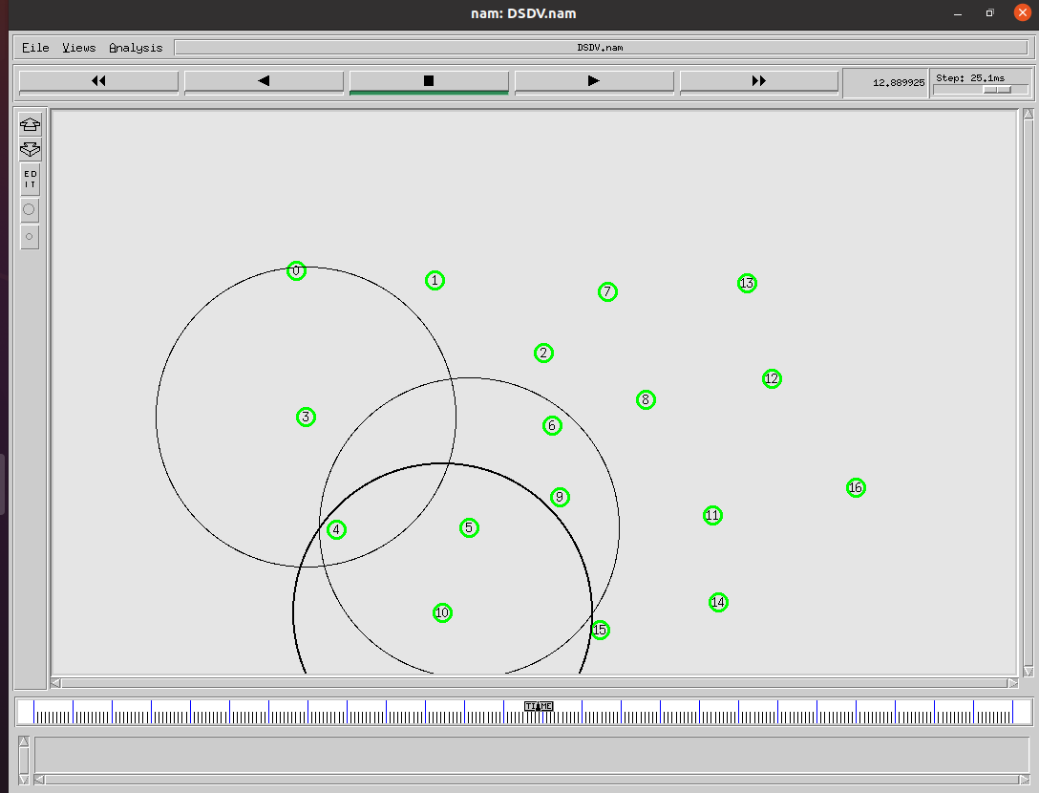
A Snapshot of the Simulation of DSDV in NAM for 17 Mobile Nodes
( Small number, to analyze the performance of DSDV )
Mobility models are used describe the movement pattern of mobile nodes in an ad hoc network. As the location, velocity and acceleration change over time with the change in movement of the nodes. Since mobility patterns play a vital role in determining the protocol performance, it is important for mobility models to simulate the movement pattern of targeted network in a reasonable way. When the network is relatively stable, incremental updates are sent to avoid extra traffic and full dump are relatively infrequent. In a fast-changing network, incremental packets can grow big so full dumps will be more frequent.

Slide 15
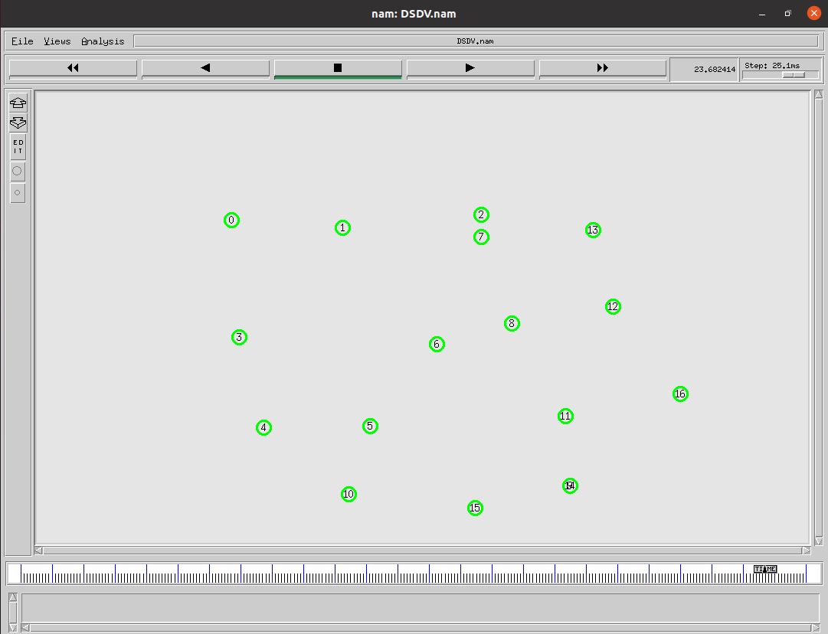
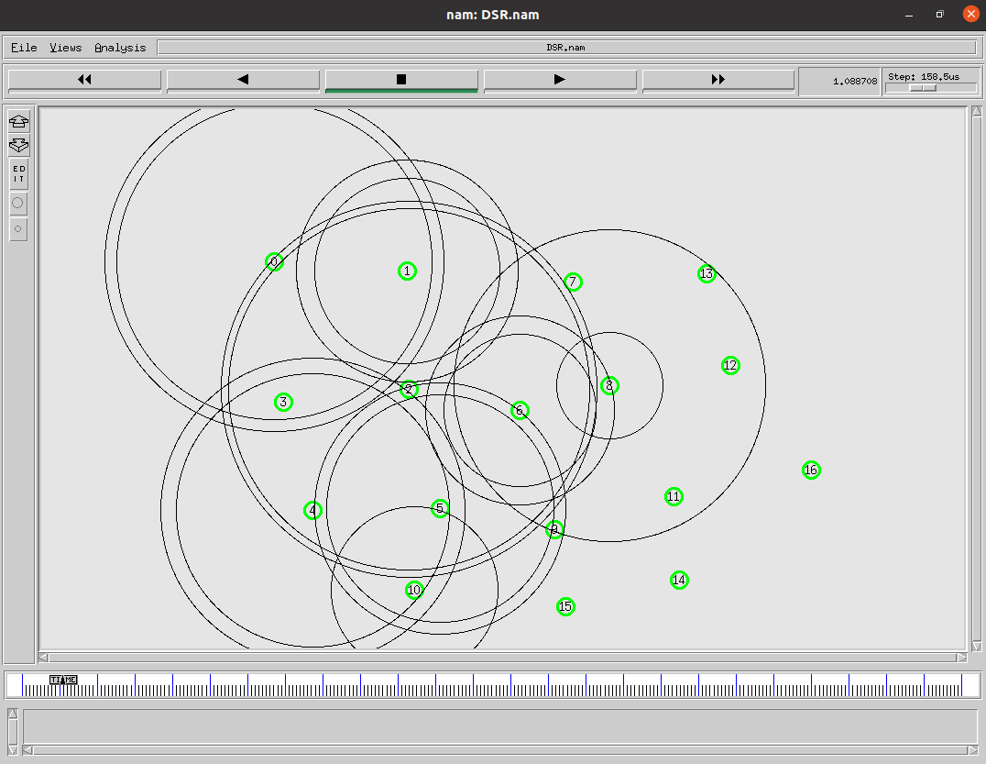
A Snapshot of the Simulation of DSRin NAM for 17 Mobile Nodes . Consider a source node that does not have a route to the destination. When it has data packets to be sent to that destination, it initiates a RouteRequest packet. This RouteRequest is flooded throughout the network. Each node, upon receiving a RouteRequest packet, rebroadcasts the packet to its neighbors if it has not forwarded it already, provided that the node is not the destination node and that the packet’s time to live (TTL) counter has not been exceeded.

Slide 16
MANET ROUTING PROTOCOL COMPARISON

Slide 17
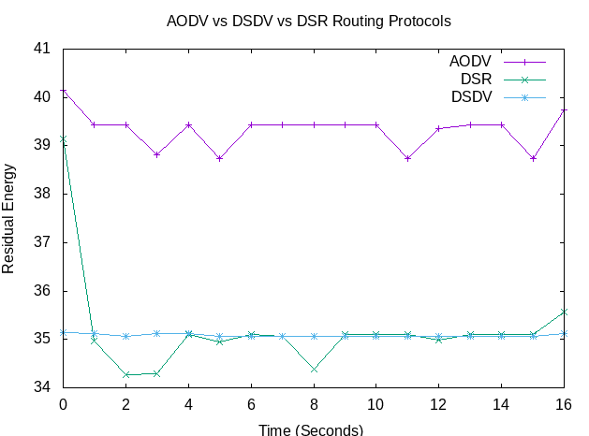
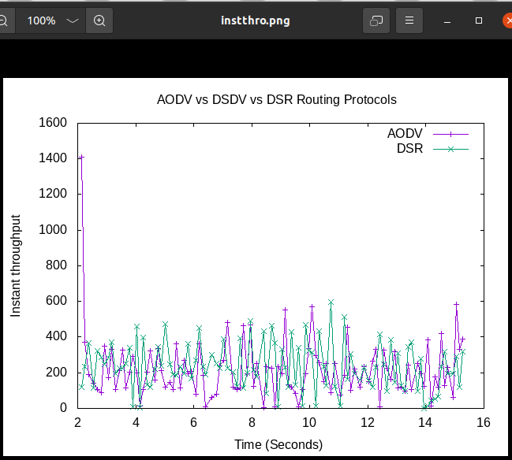
Residual Energy=Total Energy-energy consumed and Total energy consumed(ith node)=energy consumed(ith node). In case of DSDV, even though network is idle it requires a continuous update of its routing table which consumes battery power and little amount of bandwidth. Energy consumption is less in AODV than DSDV protocol, as observed since Residual energy for AODV is the highest. The performance of AODV is better than DSR in terms of throughput, which is the rate of successfully transmitted data per second in the network during the simulation. For Corresponding Data Click here.

Slide 18
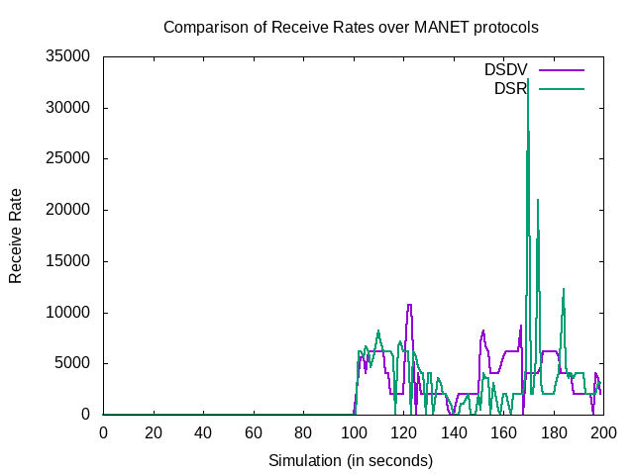
DSDV VS DSR
Packet receiving statistic were performed for several propagation delays in case of DSDV AND DSR protocols, whose nature of packet variation becomes as in shown graph.
DSR perform better when the propagation delay of nodes increases because nodes become more stationary will lead to more stable path from source to destination. DSR is superior to DSDV especially when the node’s propagation delay begins to rise.
For Corresponding Data Click here.

Slide 19
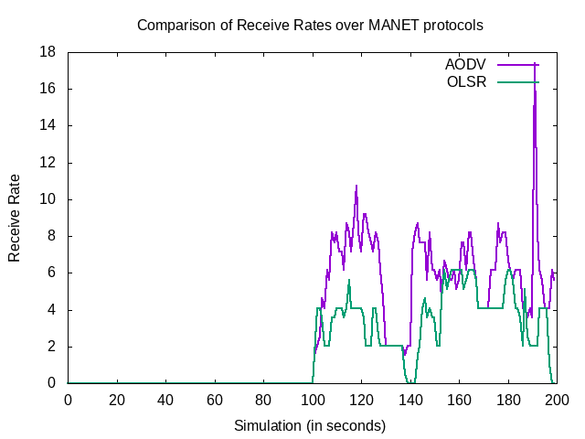
AODV VS OLSR
The packet receive rate of AODV is greater than OLSR. But as observed, at high mobility both behave the same.
Protocol which has high receive rate is considered to be a better protocol as it denotes the number of packets received by a destination.
As OLSR must maintain up-to-date information at anytime, it decreases the network performance as more network overhead is needed.
For Corresponding Data Click here.

Slide 20
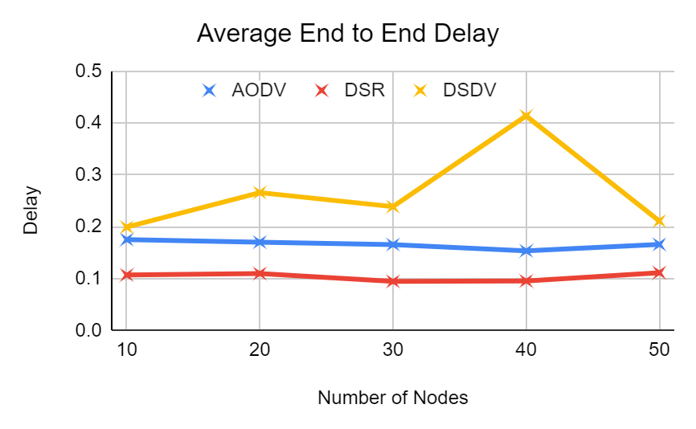
As we see the graph given here , we can infer that DSDV has high average end to end delay followed by AODV and then DSR which has the least. The performance of DSDV is degrading due to increase in the number of nodes the load of exchange of routing tables becomes high and the frequency of exchange also increases due to the mobility of nodes.
For Corresponding Data Click here.

Slide 21
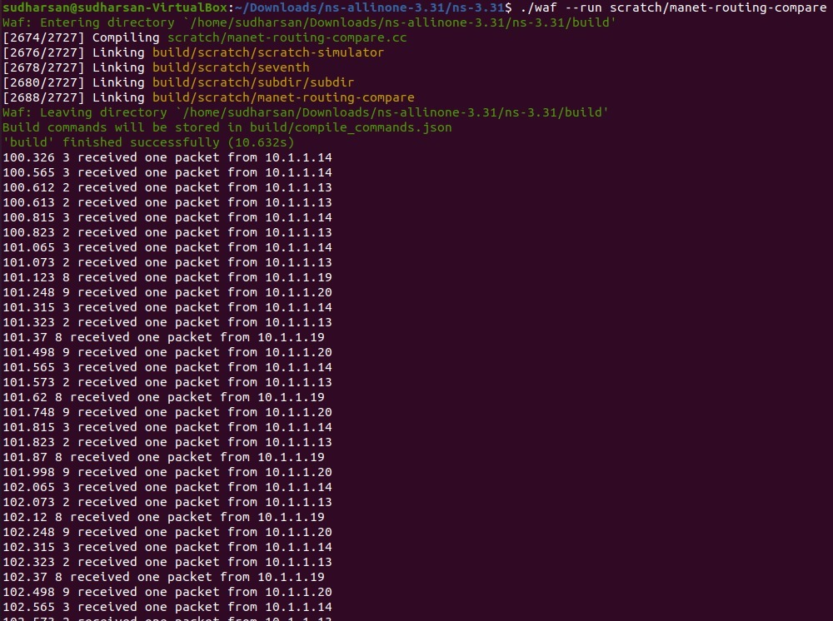
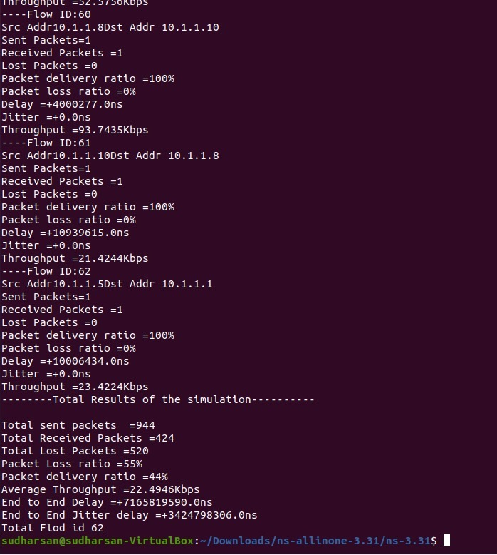
Analysing Packet Loss Ratio, Packet Delivery Ratio, Average Throughput, End to End delay, Total Jitter Delay of different MANET Routing Protocols in NS3 and obtained the results, tabulated here.

Slide 22
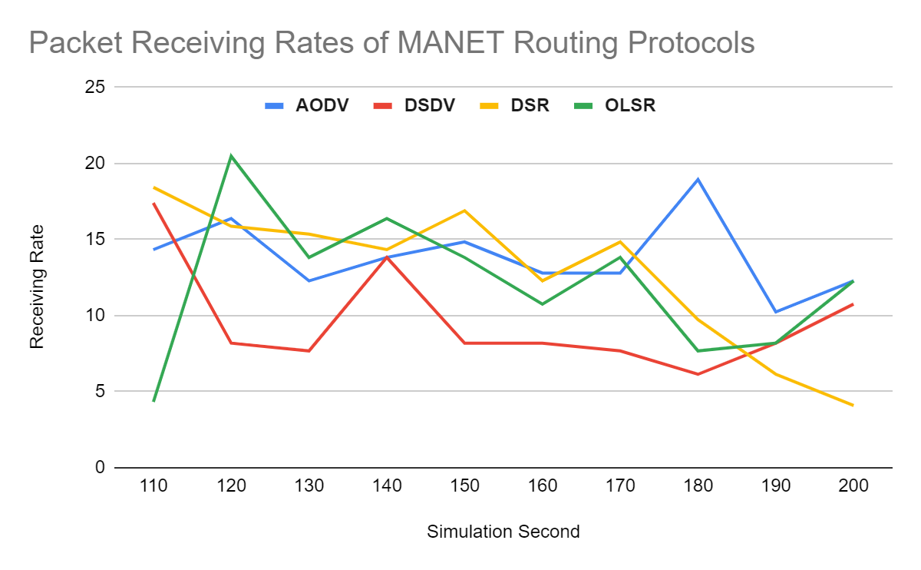
We calculated the packet receiving rate of MANET network based protocols such as AODV, DSDV, DSR and OLSR. . We simulated these protocols in NS-3 and evaluated the performance characteristics like number of packets per sec, transmission power and receiving rate. Graphs are also plotted for the same and the results show that the OLSR protocol has the maximum packet receiving rate compared to other routing protocols.
Corresponding data here

Slide 23
Conclusion on MANETs
The significant observation is, simulation results agree with expected results based on theoretical analysis. We took the same set of mobility scenarios for each variation of node speed and variation of the number of nodes while changing the routing protocol.. We find that the performance varies widely across different number of nodes and different types of speed in node mobility. AODV performance is better, considering its ability to maintain connection by periodic exchange of information, which is required for TCP, based traffic. DSR as observed in the NAM, performs well in all mobility rates, and we observed that DSR requires the transmission of many routing overhead packets. DSDV performs quite predictably, delivering nearly all knowledge packets once node quality rate and movement speed area unit low, and failing to converge as node quality will increase. Average End-to-End Delay is the least for DSDV and does not change if the no of nodes are increased. OLSR and DSDV are best suited for networks with high density and low latency, as the average end-to-end delay was significantly lower than other protocols and the throughput did not decrease with increase in number of nodes.

Slide 24
TCP VARIANTS OVER ROUTING PROTOCOLS
Despite the fact that considerable simulation work has been done, still more investigation is needed in the fairness of the TCP traffic and mobility models. Difficulty exists to analyze fairness of TCP flows using TCP variants over routing protocols based only on mathematical and theoretical calculations. There are a lot of different parameters that need to be considered. Implementation of wireless network topology using simulators helps to overcome these difficulties. That is why, we simulated the MANET routing protocols prior to moving on to this one.
The interaction of MANET with the TCP protocol structure may lead to impulsive phenomena like severe unfairness problem between simultaneous TCP flows.

Slide 25
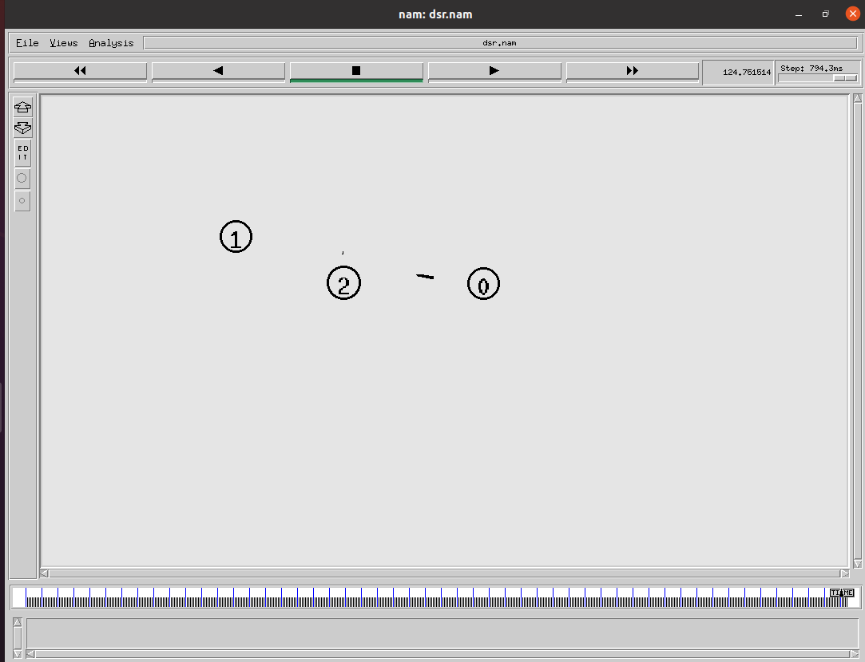
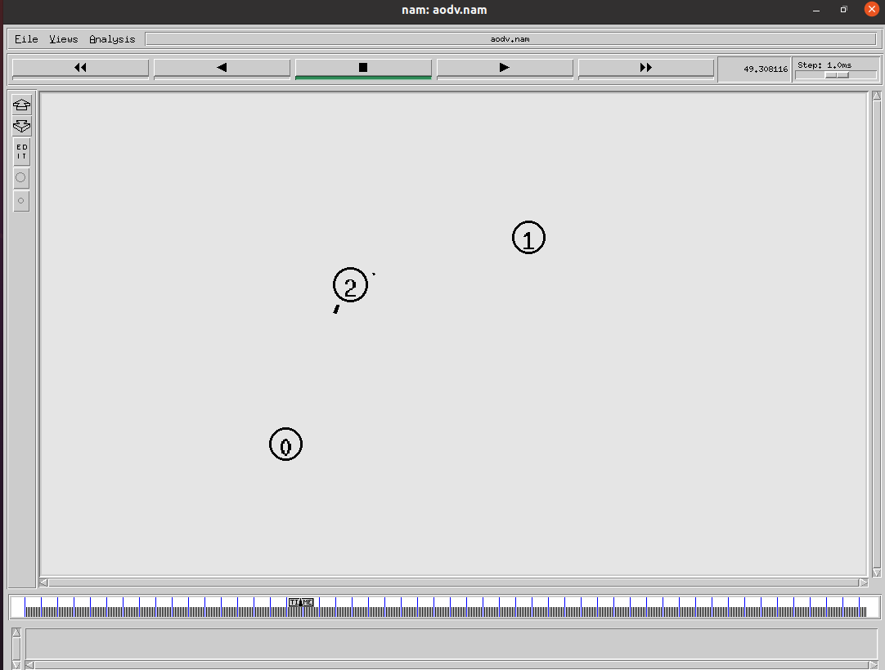
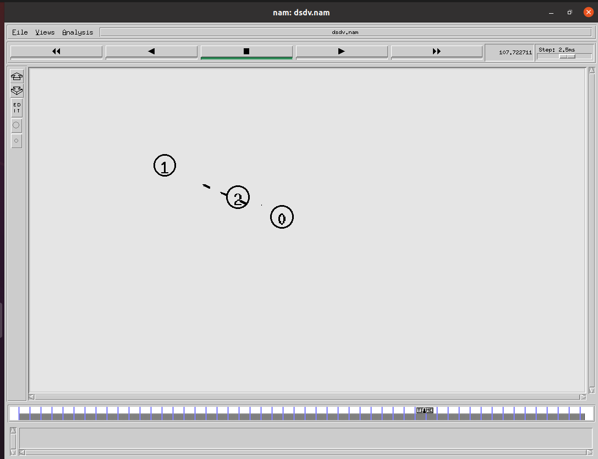
TCP Variants are simulated over AODV, DSDV and DSR routing protocols and the topology and the results are to be seen here. The tabulation results for the same can be found here. The performance of TCP is largely dependent on the underlying routing protocols. From the scenario generated, it is seen that , since TCP variants do not have mechanism to know the route re-establishment period; the throughput can degrade because of the large delay to transmit packets.

Slide 26
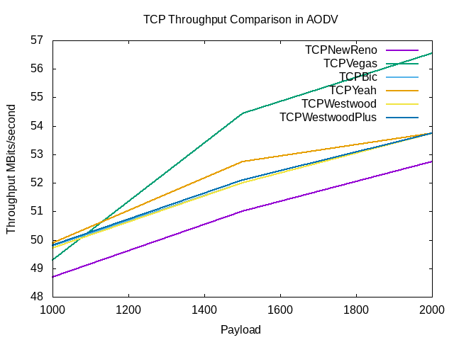
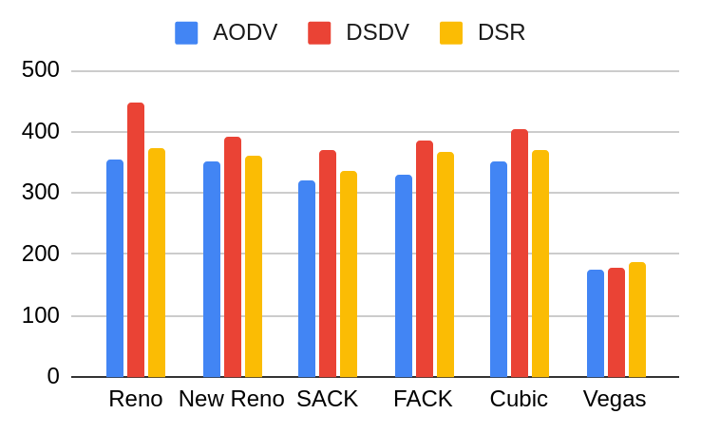
Here AODV, DSR and DSR are simulated with different TCP algorithms for analyzing the throughput . In the adjacent topology, for constant movement of nodes throughout the simulation we set the pause time to 0. ll mobile nodes in the network are configured to run AODV,
AOMDV, DSDV and DSR protocols and multiple FTP sessions using six TCP variants namely TCP Vegas, TCP Reno, TCP New Reno, TCP SACK, TCP FACK and TCP Cubic. The fairness of TCP Variants in wireless mobile network is evaluated in our simulation experiment and graphs are shown as below.

Slide 27
CONCLUSION
The fairness of TCP Variants in wireless mobile network is evaluated in our simulation experiment, using six TCP variants on four routing protocol of which each node share FTP connections randomly. Sender and receiver are chosen randomly by calculating shortest possible path.By measuring throughput fairness and packet drop behavior of TCP flows we can understand how TCP Variants reacts to the mobile ad hoc network conditions which will help us to understand how reactive and proactive routing protocol has facilitated TCP Variants operation. As throughput is a positive value, the throughput fairness of a set of TCP flows will always lie between 0 and 1. TCP Vegas received the most unfair throughput over four routing protocol. In our simulation, eight senders try to send packet at a time, as a consequence collisions occur so frequently which indicate congestion in mobile ad hoc network. As Reno ﬂows are more aggressive, as a result, can achieve higher throughput comparing with other TCP Variant. As shown in the data,
From our analysis, we have found that TCP Vegas achieves unfair throughput comparing with other TCP variants over four of the routing protocol named AODV, DSDV, and DSR. It also showed an inconsistent performance for all four routing protocols as an average. From TCP variants, TCP Reno outperforms other TCP variants under DSDV routing protocol.. As DSR responds quickly to link failure which circumvents TCP’s deployment acknowledge at low pause time. The generic investigation from the simulation is that for throughput fairness of TCP flows and packet drop behavior existing DSDV, outperforms AODV, and DSR in more “stressful” topology like for an increased number of nodes and high mobility pattern. After DSDV, it is DSR that performs well with TCP variants.

Slide 28
Goals for next meeting
Document simulation and finish conclusion
Do more research to come up with a novel idea
Check out all experimental data (csv) here

Slide 29
Thank you

